Slide 1
Pyramid Lottery
Never Lose! A solana-based asset restaking protocol

Slide 2
Problem Statement
Not enough winners!
We gamble in lotteries and do not win! This is terrible!
We want to win! We will win!

Slide 3


Solana Asset Restaking Protocol
- Pyramid Lottery allows restaking of ticket assets into multiple lotteries
- Since your ticket is always valid and can be restaked into many lotteries, all purchased tickets will eventually win!

Slide 4
Permissionless Lottery System with 3 roles
- Anyone can join the protocol as one of the 3 main roles:
- Winner: ticket restakers, engages in community building to boost their potential winnings
- Lottery Manager: seeks individuals out to participate in their lottery for a change to win, community building with existing Winners and recruiting new Winners
- Pool Manager: oversees funding pool for many lotteries, community building role

Slide 5
v0.0.1 Deployed to Devnet
https://explorer.solana.com/address/EFSsGtygxE3CoYqrxY9hAJ6nLuL2SNyLnrzLAsyWJo3P?cluster=devnet

Slide 6
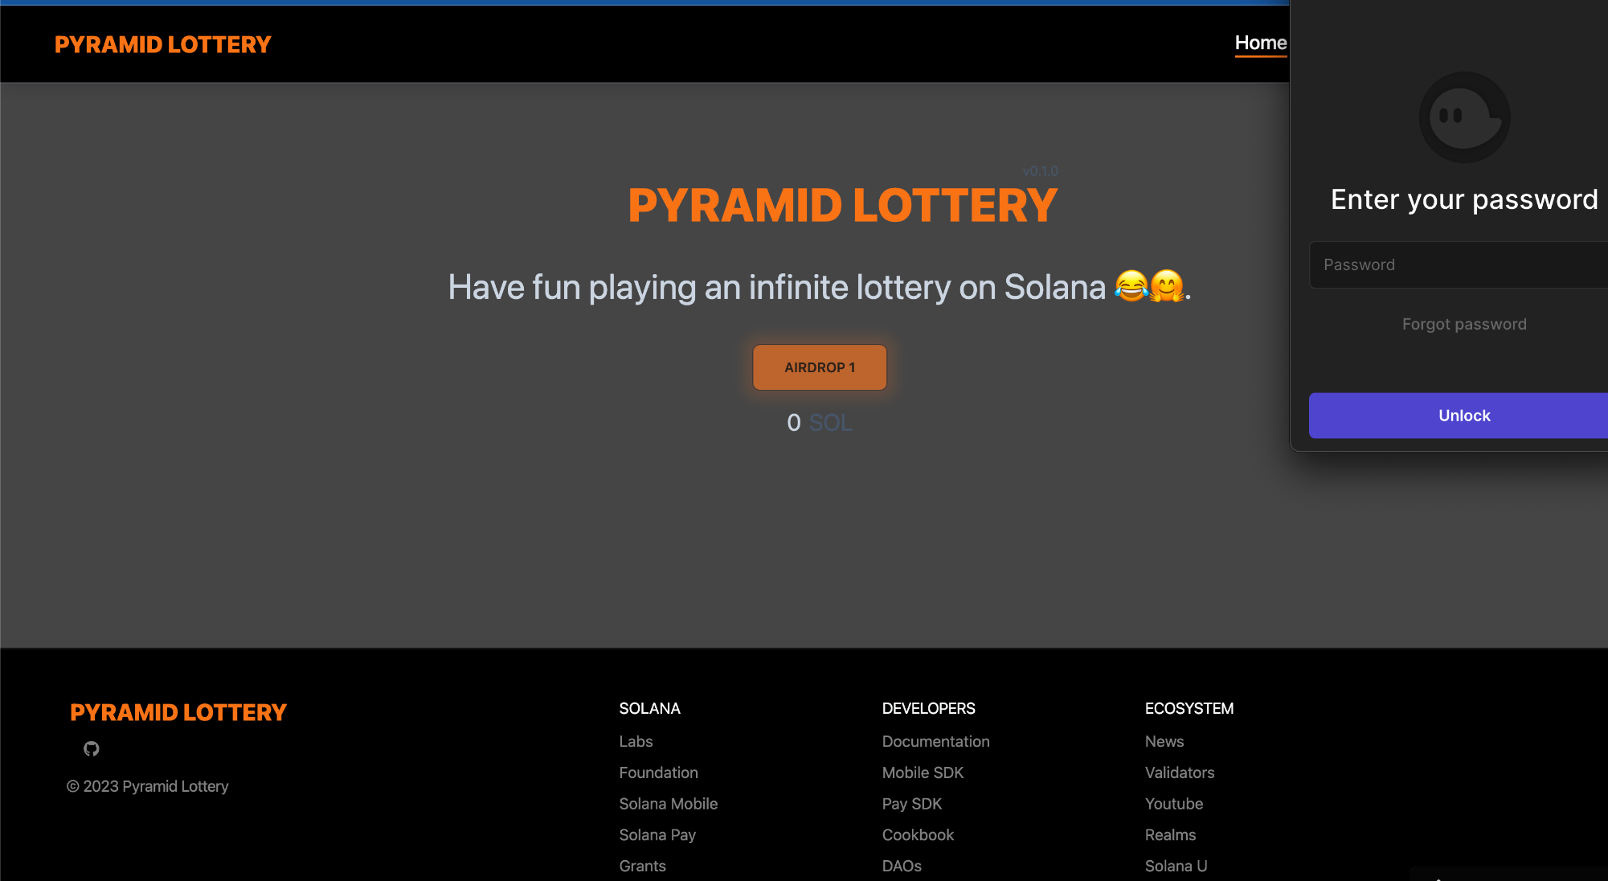

Slide 7
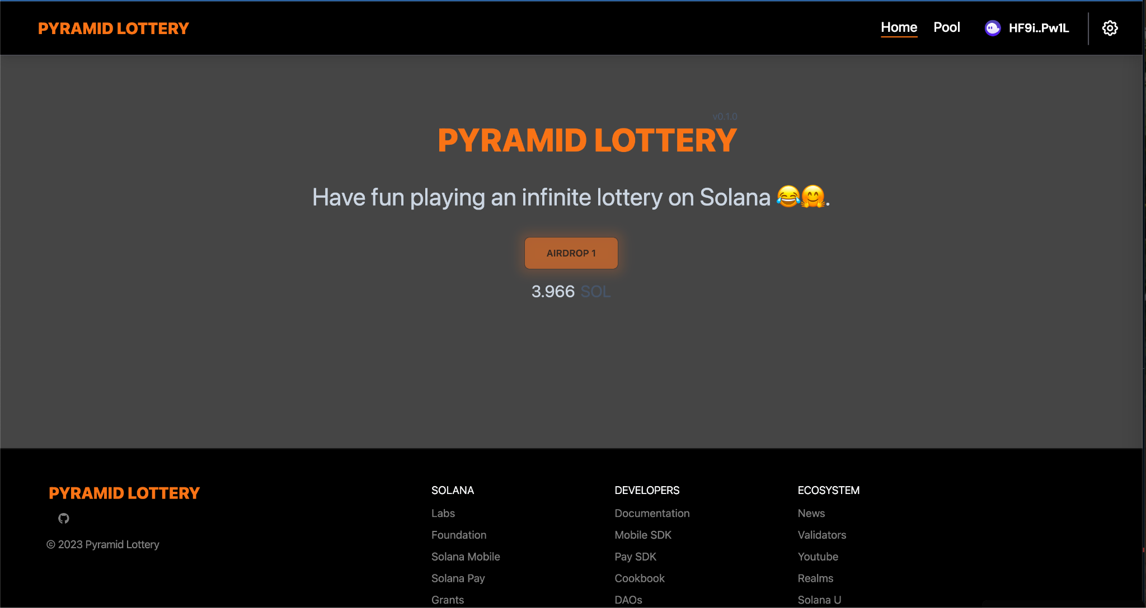

Slide 8
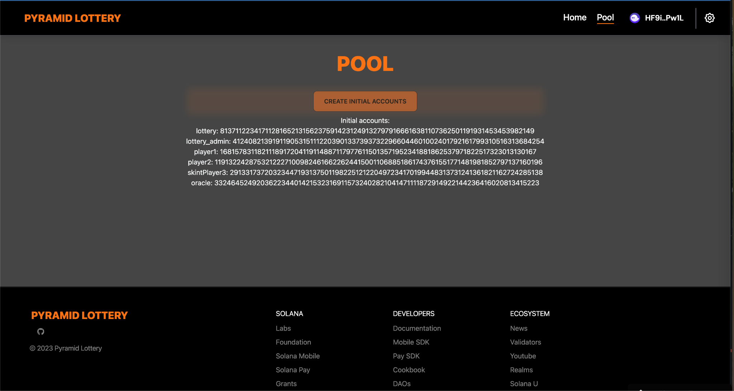

Slide 9

Github
If you want to check the code on how to always win in a lottery, visit us at:
https://github.com/PizzaHi5/PyramidLottery

